Slide 1
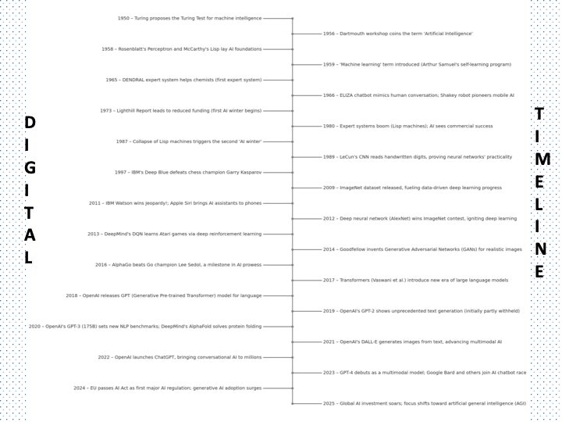
Notes:
Artificial Intelligence (AI) has evolved through cycles of optimism, breakthrough, and setback from its mid-20th century inception to today’s era of ubiquitous generative AI. The timeline below highlights global events in AI – not just a few key moments, but a comprehensive progression – from early academic ideas to modern industry-changing innovations. Each date includes a brief note on its significance. (Sources for these milestones are cited after the timeline.)
Timeline of AI (vertical, 1950–2025) highlighting major developments each year. Early milestones like the 1956 Dartmouth workshop (which officially coined the term AI) and the 1960s’ first chatbots and robots set the stage. The timeline shows the “AI winters” of reduced funding (mid-1970s and late 1980s) and the revival through expert systems in the 1980s. It traces the rise of machine learning breakthroughs – from the 1997 Deep Blue chess victory, to the 2012 deep learning revolution, and onward to transformers and large language models that culminate in ChatGPT (2022) and today’s race toward ever more general AI.

Slide 2
Historical Context – Major Milestones in AI (1950s Onwards)
📘 1950 – The Turing Test
➡️ Alan Turing introduces a benchmark for machine intelligence, laying AI’s philosophical foundation.
🎓 1956 – The Birth of AI
➡️ Dartmouth Conference officially launches AI as a field of study, coined by John McCarthy.
💬 1960s – Early AI Programs
➡️ Programs like ELIZA and SHRDLU showcase early attempts at language understanding.
⚙️ 1970s – Expert Systems Emerge
➡️ Systems such as MYCIN demonstrate how AI can make specialized decisions using rules.
🧠 1980s – Neural Network Revival
➡️ Backpropagation brings neural networks back to life, enabling computers to “learn” from data.
♟️ 1997 – IBM Deep Blue Triumph
➡️ AI makes history by defeating world chess champion Garry Kasparov, proving its strategic power.
🌐 2000s – AI in Daily Life
➡️ AI becomes mainstream with smart assistants, recommendation engines, and online personalization.
🚀 2010s – Deep Learning Revolution
➡️ Advances in GPUs and big data fuel breakthroughs in vision, speech, and natural language.
🤖 2020s – Generative AI Era
➡️ AI models like ChatGPT transform creativity, automation, and human-computer interaction.

Slide 3
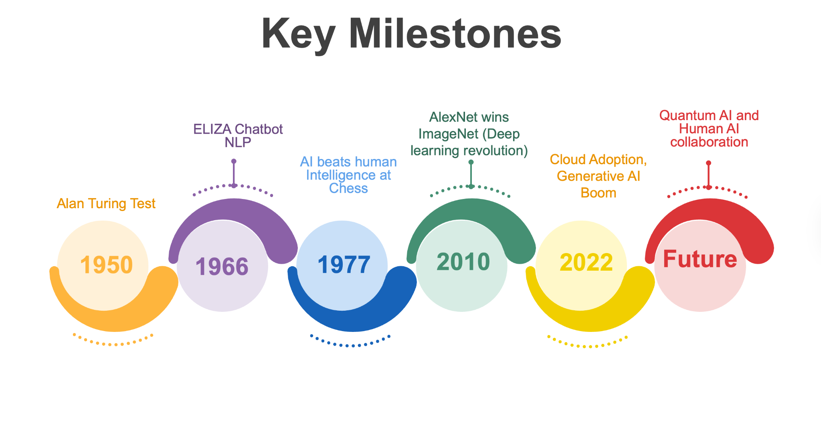
Notes:
1️⃣ Turing Test – A test where an evaluator tries to tell apart a human and a machine; if they can’t, the machine is considered intelligent.
2️⃣ ELIZA Chatbot – Used pattern matching and prewritten responses to simulate human conversation — the first step toward modern chatbots.
3️⃣ 1977 Milestone – Machines began processing data, calculating moves, and making logical decisions, outperforming humans in specific tasks.
4️⃣ Neural Networks & Vision – Neural networks revolutionized computer vision by recognizing images more accurately than ever before.
5️⃣ Cloud & Generative AI – Platforms like AWS, Azure, and Google Cloud powered the rise of Generative AI models such as GPT-3.
6️⃣ Quantum AI Future – Quantum computing could make AI 13,000× faster, supercharging intelligence and solving problems beyond today’s limits.

Slide 4
AI Winters
It is a period when funding for AI is less, reduced interest. Happened after periods when the outlook was promising, and the field well funded.
Two major "winters" 1974–1980 and 1987–1993
First AI Winter
The initial optimism and ambitious predictions about AI's potential led to unrealistic expectations. The technology available during the time placed limitations on what was possible.
Lighthill Report published in 1973 by Sir James Lighthill which criticized failure to achieve "grandiose objectives” in AI dealt a heavy blow to AI research in UK and in the US.
Second AI Winter
The 1980s success of expert systems (specialized systems that try to duplicate expertise in a field, say an engineer) led to another increase in expectations about AI's capabilities. The expert systems were often limited to highly specific domains and required substantial manual input to build and updating of their knowledge bases with new data, and failed to operate outside the set rules.
The result was that many AI applications failed to live up to the hype, leading to disappointment among investors and the public.
There was a significant drop in investments, as the industry re-assessed the viability of AI technologies.
2020s have been a period of highest interest and funding, and chatbots like ChatGPT released in 2022 have led to extensive discussions about effect of AI on the world.

Slide 5
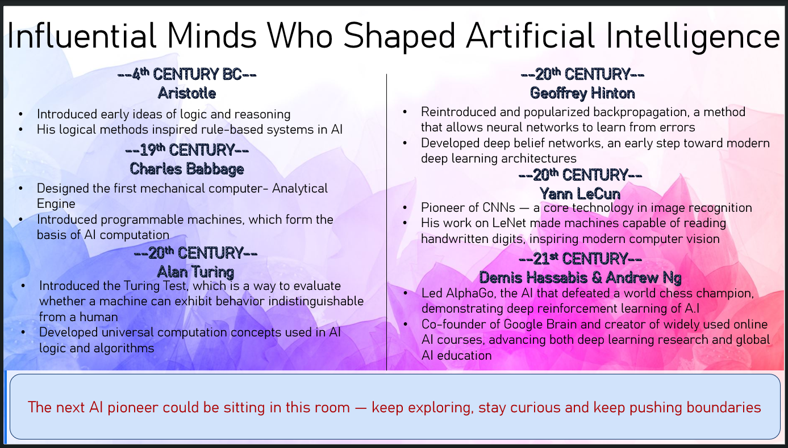

Slide 6
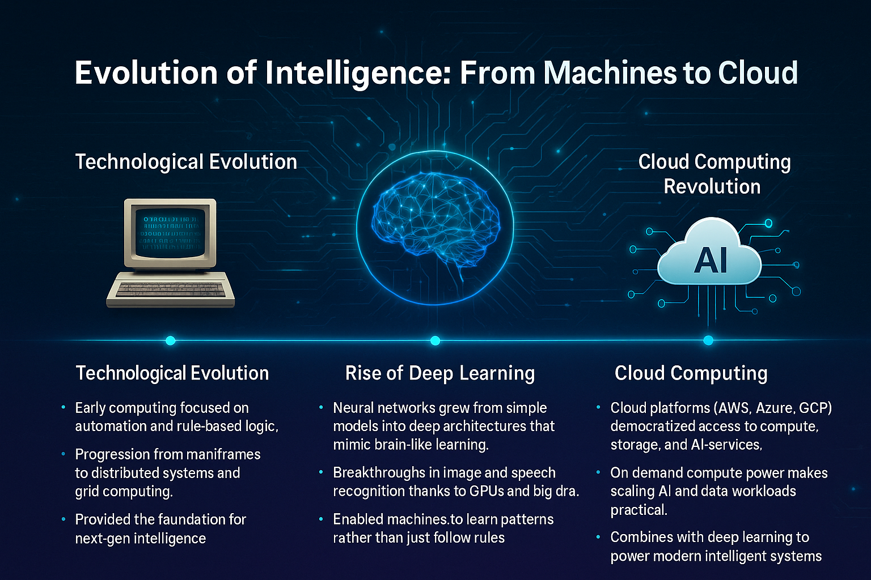

Slide 7
Artificial Intelligence and its Future
Today is properly known as Narrow or Weak AI, in that it is designed to perform a narrow task (eg. only facial recognition or only internet searches or only driving a car, embedded in your GPS Systems and amazon recommendations)
However, the long-term goal of many researches is to create general AI( AGI or Strong AI).
While narrow AI may outperform humans at whatever its specific task is, like playing chess or solving equations and AGI a self teaching system would outperform humans at nearly every cognitive task.
Human-level intelligence: AGI would have the ability to think, reason, and make decisions like a human, without being confined to one specific task or domain.
Adaptability and flexibility: It would be able to adapt and apply its knowledge to new and unfamiliar problems, rather than just relying on pre-programmed patterns.
Genuine understanding: AGI would go beyond pattern matching to comprehend underlying concepts and context, something current AI struggles with.
Common sense and reasoning: It would be capable of common sense reasoning, making logical leaps that are clear to humans but difficult for current systems.

Slide 8
References
Turing, A. M. (1950). Computing machinery and intelligence. Mind, 59(236), 433–460.
Weizenbaum, J. (1966). ELIZA—a computer program for the study of natural language communication between man and machine. Communications of the ACM, 9(1), 36–45.
OpenAI. (2023). GPT-4 technical report. arXiv preprint arXiv:2303.08774.
“The Complete Timeline of Artificial Intelligence: From Theory to Modern AI Revolution (1950-2025)”, QuillCircuit blog.
Noguer i Alonso, M. (2024, October 8). Geoffrey Hinton’s contributions to neural networks: A detailed mathematical exploration.
Goodfellow, I., Bengio, Y., & Courville, A. (2016). Deep Learning. MIT Press.
Mell, P., & Grance, T. (2011). The NIST Definition of Cloud Computing. NIST.
Russell, S., & Norvig, P. (2021). Artificial Intelligence: A Modern Approach (4th ed.). Pearson.
LeanIX GmbH. (2024). Complete History of AI | LeanIX. Leanix.net. https://www.leanix.net/en/wiki/ai-governance/history-of-ai
Wikipedia Contributors. (2019, October 9). AI winter. Wikipedia; Wikimedia Foundation. https://en.wikipedia.org/wiki/AI_winter‌

